Slide 1
ELT Kimball Modeling with Visual Metabase
DataCraft :
Dibimbing.id – Final Project Data Engineer Batch 2
Muhammad Muhidin

Slide 2
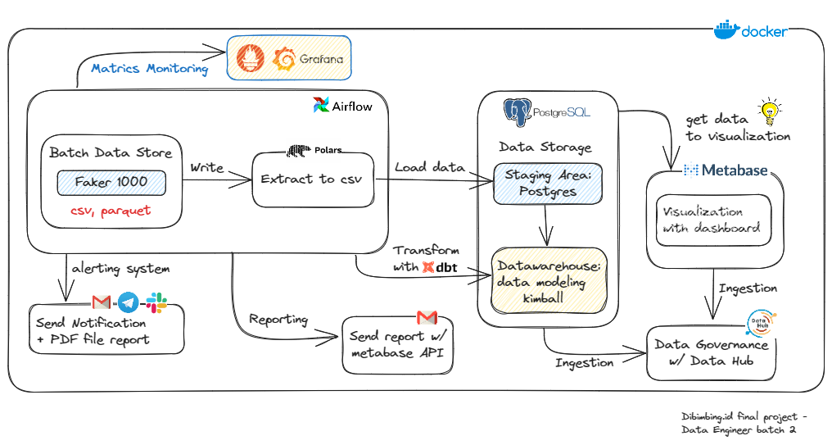
Infrastructure of Pipeline
Raw data from faker will be extracted by polars into csv format, then PostgresOperator with .sql write to postgres. after that airflow send dbt run command to transformation data. airflow will use the metabase api to send reports via email. a metabase get data from postgres to visualization. and use prometheus for monitoring.

Slide 3
Data Flow
Extract
Transform
Visualize
Source Data
Staging Area
Warehouse
Metabase
Load

Slide 4
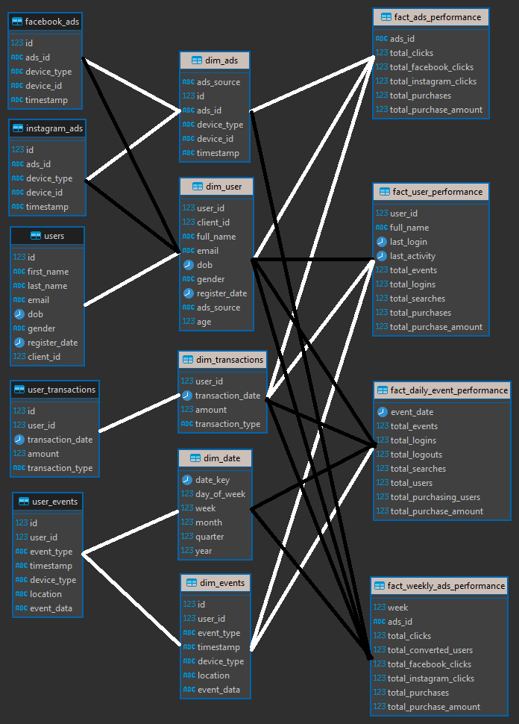
Entity Relationship Diagram (ERD)
relations from dim and fact tables

Slide 5
DBT ( T in Transformation )
Dbt Project &
Profiles
Models
Schema
SQL

Slide 6
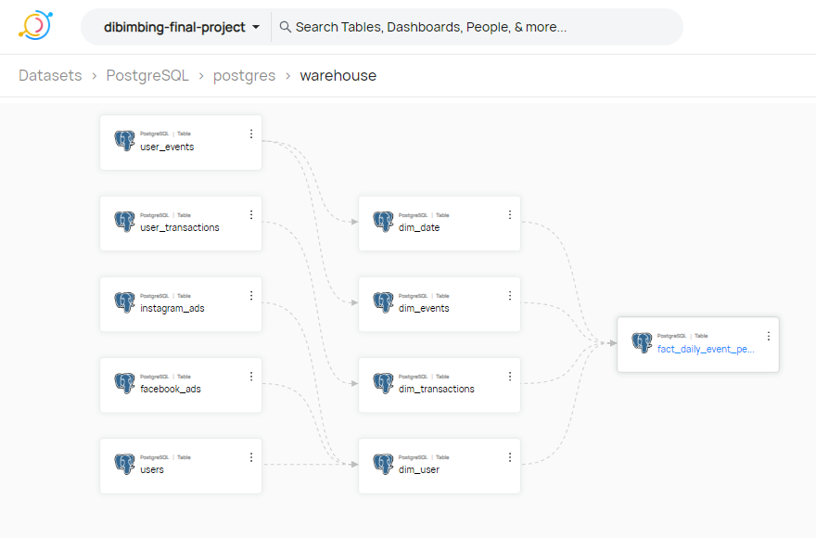
Data Hub

Slide 7
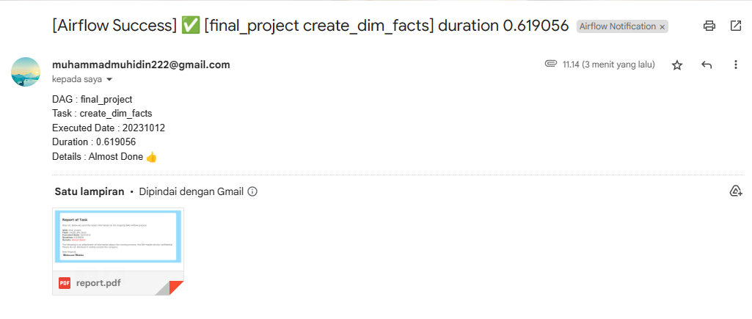
Email Notifications

Slide 8
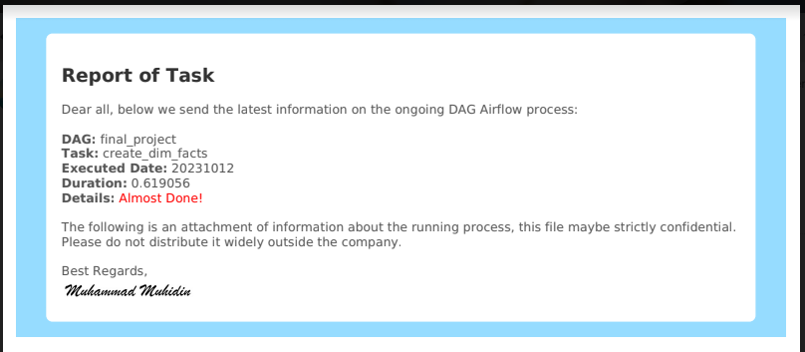
Report Attachment (Email)

Slide 9
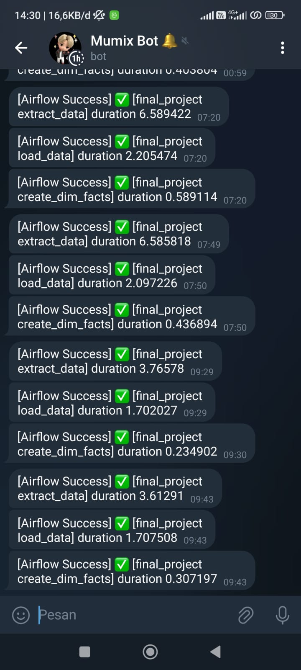
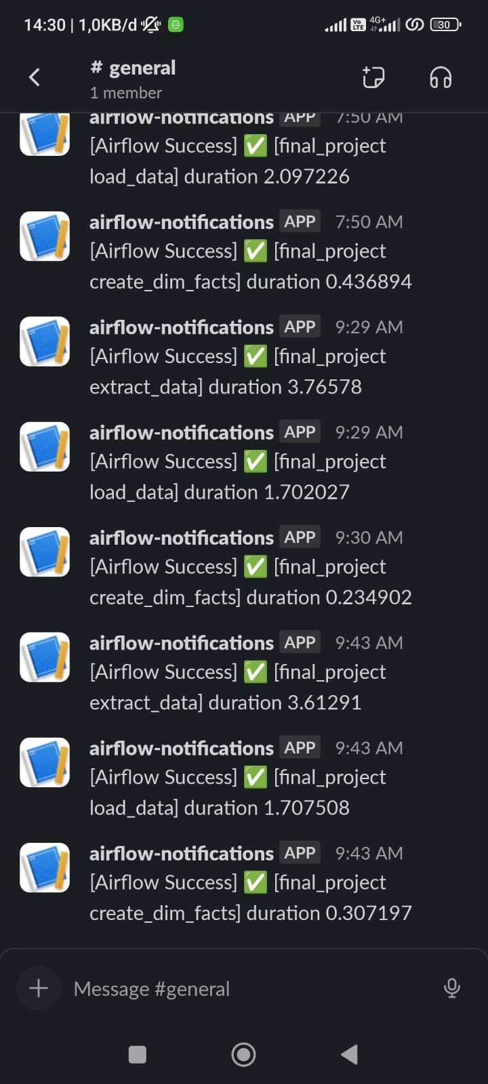
Telegram and Slack Notifications
all statuses on the airflow task instance are success, retry, failure. Also sent to Telegram and Slack.

Slide 10
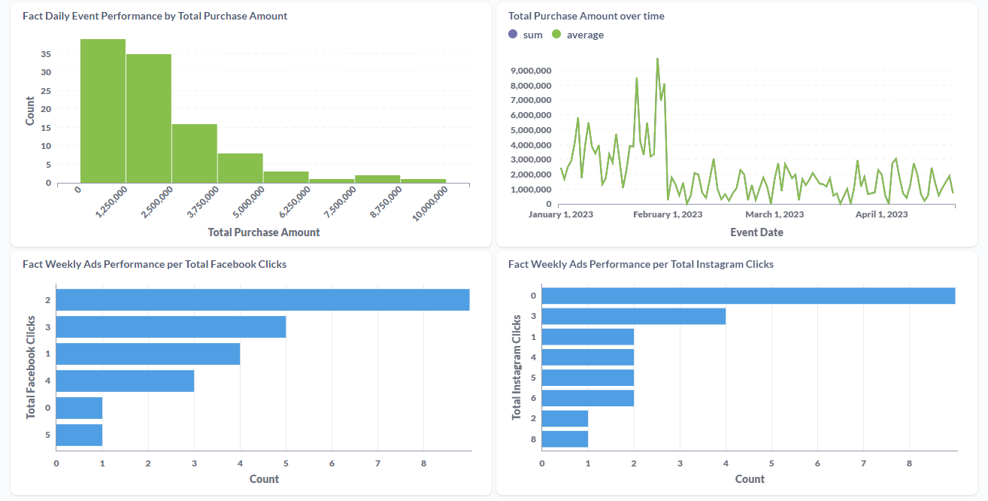
Dashboard of Metabase

